Slide 1
Task 2
Your task is to test the website(http://zero.webappsecurity.com/) and find all possible vulnerabilities and loopholes in it. To do so you can use the automatic vulnerabilities scanner “Netsparker”.
As Netsparker is not properly getting installed in my system, so I have used OWASP ZAP to test the given website and accordingly the screenshots and report are provided in next slide.

Slide 2
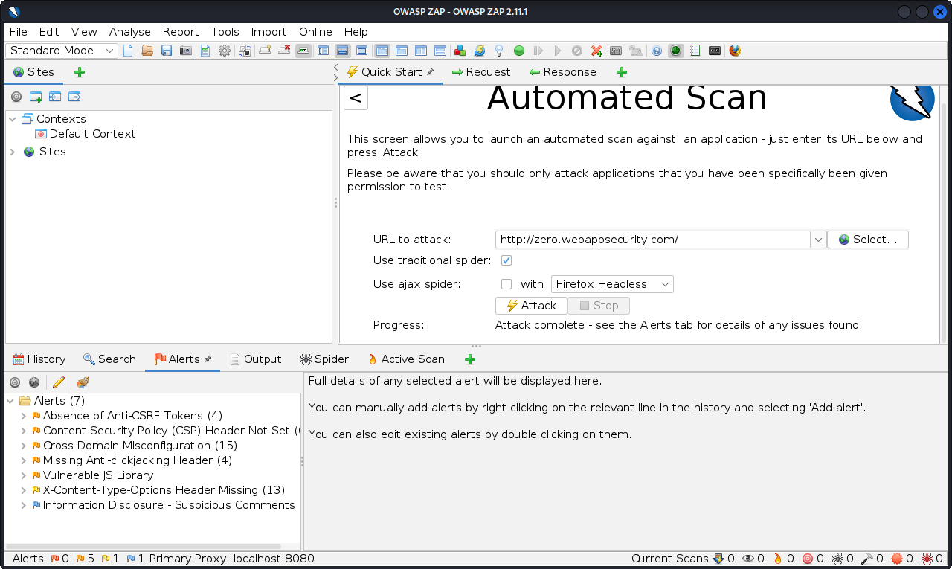
Screenshots

Slide 3
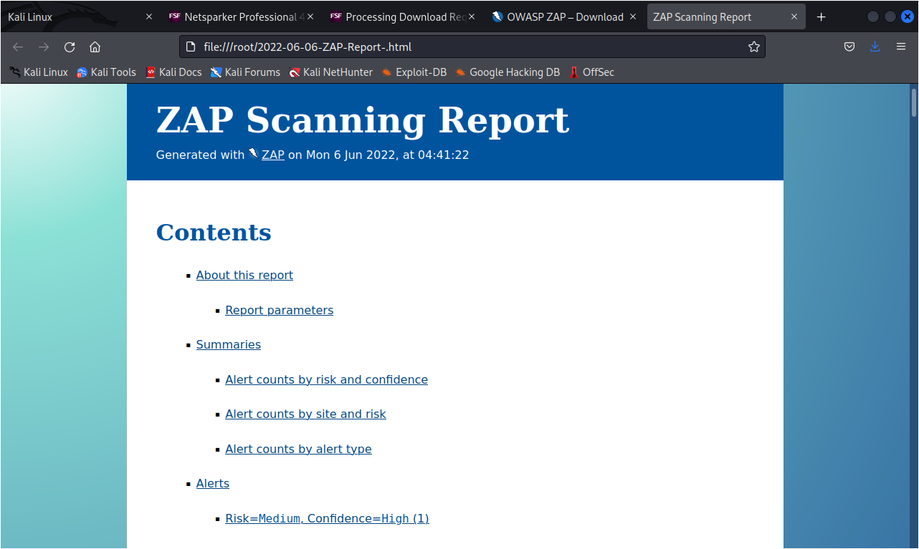
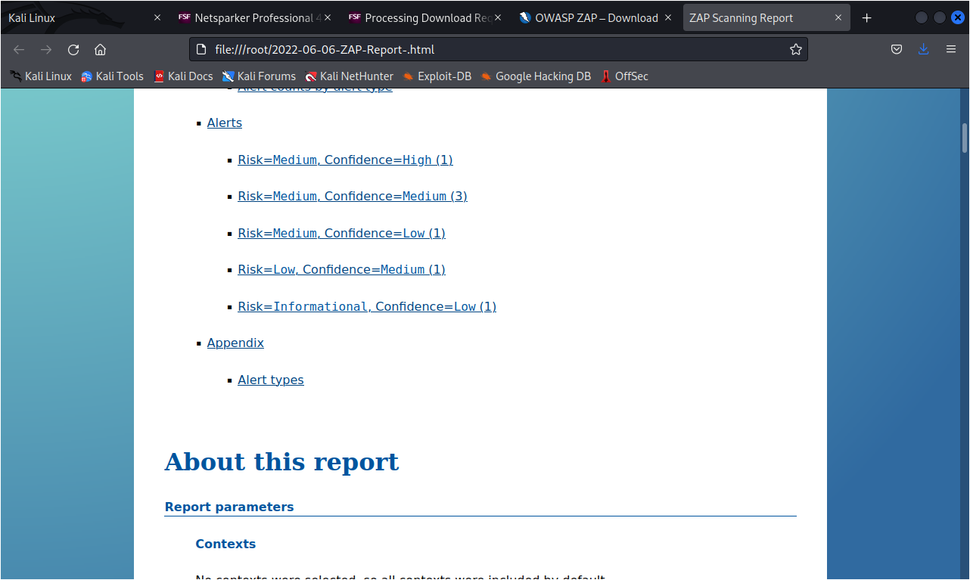

Slide 4
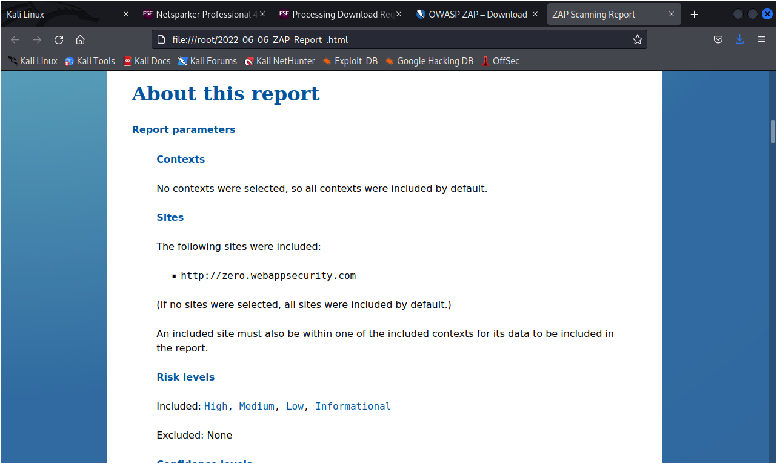
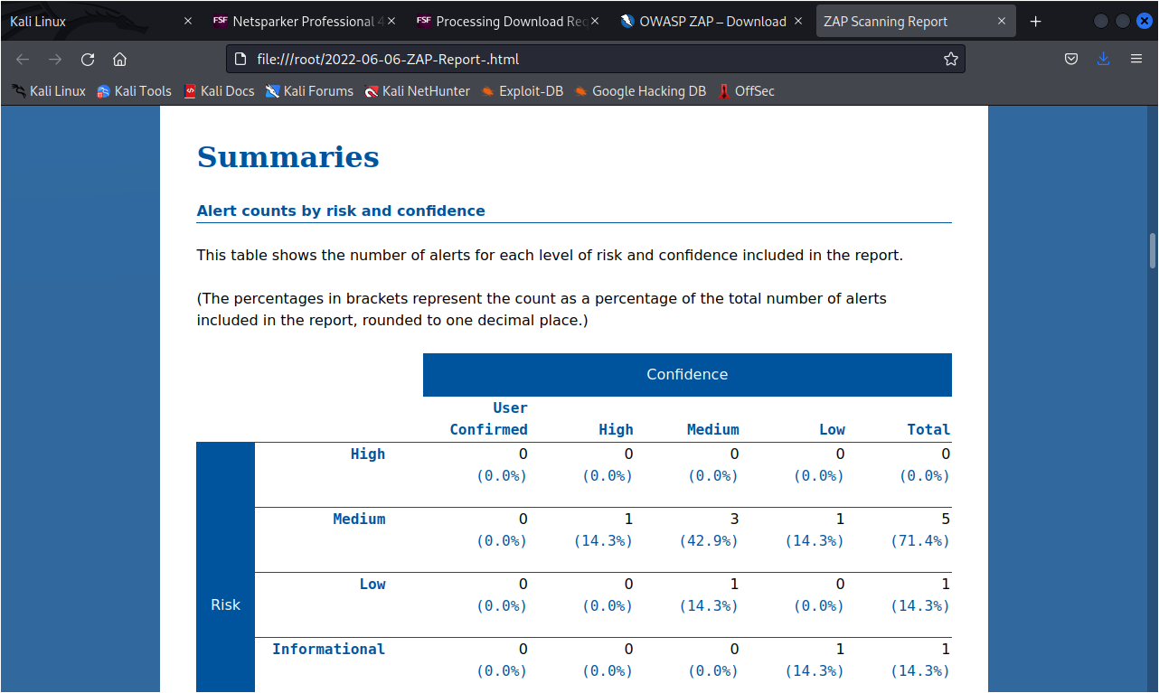

Slide 5
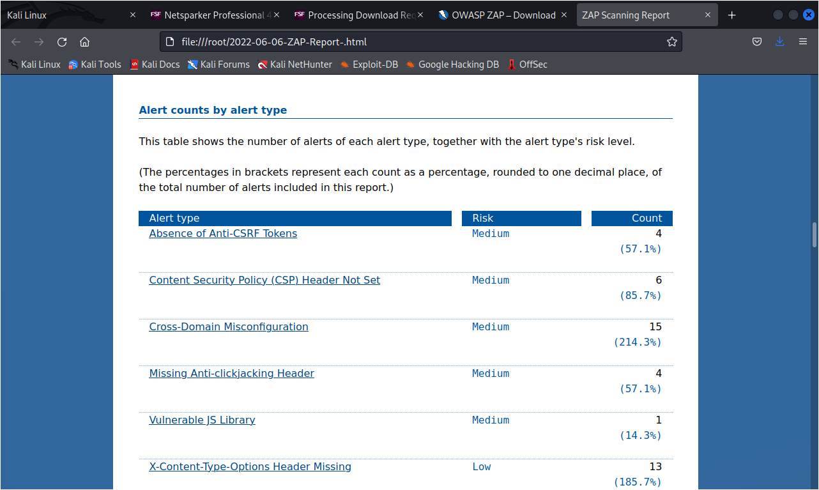
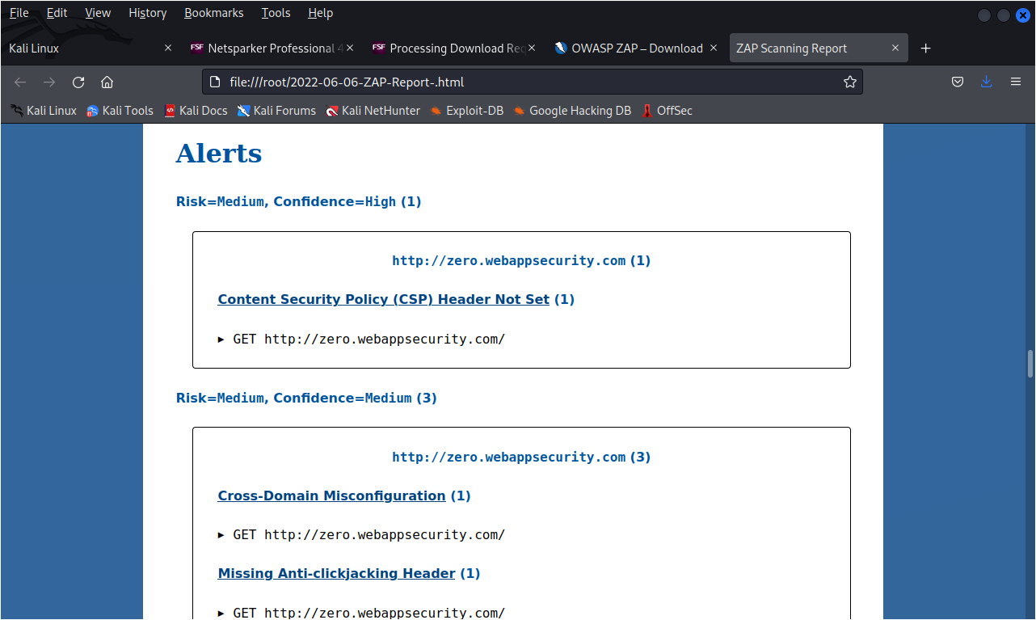

Slide 6
report
TITLE : Content Security Policy
DOMAIN : webappsecurity.com
SUB-DOMAIN : zero.webappsecurity.com
SUMMARY:
Found Content Security Policy (CSP) vulnerability on your website. As per PortSwigger website definition- CSP is a browser security mechanism that aims to mitigate XSS and some other attacks. It works by restricting the resources (such as scripts and images) that a page can load and restricting whether a page can be framed by other pages.
Developers can use CSP to protect their applications from Shadow Code injection vulnerabilities such as cross-site scripting (XSS) and reduce the privilege with which their applications execute.

Slide 7
STEPS TO REPRODUCE:
Login into your Linux system.
Open Netsparker, if it is not available then open OWASP ZAP app. You can install OWASP ZAP app from the github link provided on google and then using linux terminal to install it.
Open OWASP ZAP app and provide the URL of website to test upon in ‘ URL to attack ’ field box.
Then start attacking by clicking on Attack button.
After completion of process, you can see Attack complete on Progress section.
To view the report , click on Report section on top menu bar.
Then click Generate report.
From report you can extract all details like vulnerabilities, url’s and the solution.

Slide 8
IMPACT:
As the primary benefit of CSP is to prevent the exploitation of cross-site-scripting vulnerabilities. So if someone finds XSS bug on your website then he/she can harm your users data by injecting some XSS payload.
MITIGATION:
If you want to prevent your website to be vulnerable of Content Security Policy, then enable CSP on your browser. To enable CSP, a response needs to include an HTTP response header called Content-Security-Policy with a value containing the policy. The policy itself consists of one or more directives, separated by semicolons.

